Slide 1
Modeling GDP with Exogenous Variables
By: Julian Moreno, Ren Yang, Cameron Raughtigan, and Neel Shah

Slide 2
Objective
Explore the relationship between macroeconomic indicators and GDP
How does the significance of betas change in various periods
Use non-overlapping 5 year periods
Determine what causes the difference in significance over time

Slide 3
Pre-processing

Slide 4
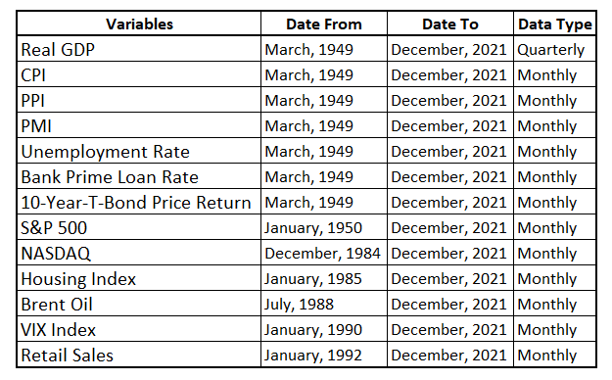
Exogenous Variables
GDP is quarterly
All exogenous variables are monthly
We include shorter period variables in later models

Slide 5
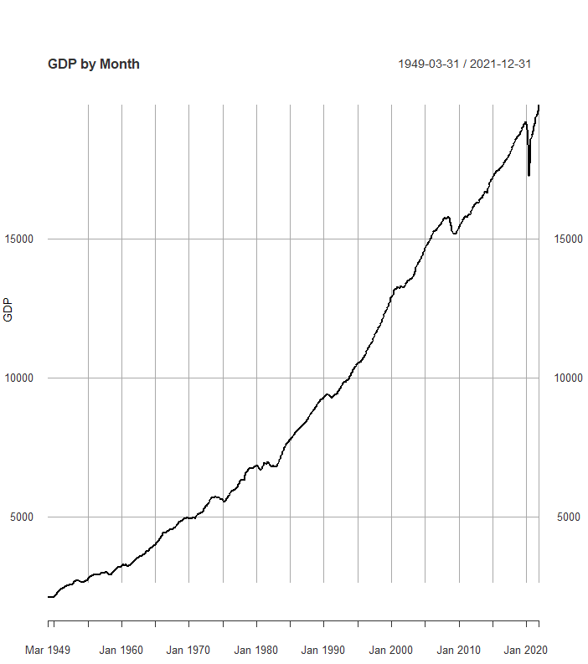
Linear Interpolation of Quarterly GDP
Straight line interpolation is used to model the monthly values between quarterly samples

Slide 6
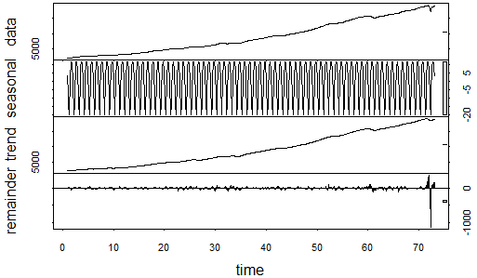
Check for Seasonality
GDP level shows seasonality
We use GDP returns to adjust for seasonality as returns are stationary

Slide 7
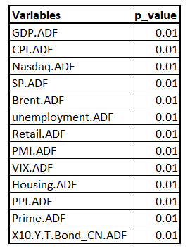
Adjusted Dickey-Fuller Test
The variables are converted to their return series
ADF test is used to test for stationarity
The p-value of all variables is 0.01
All variables are found to be stationary

Slide 8
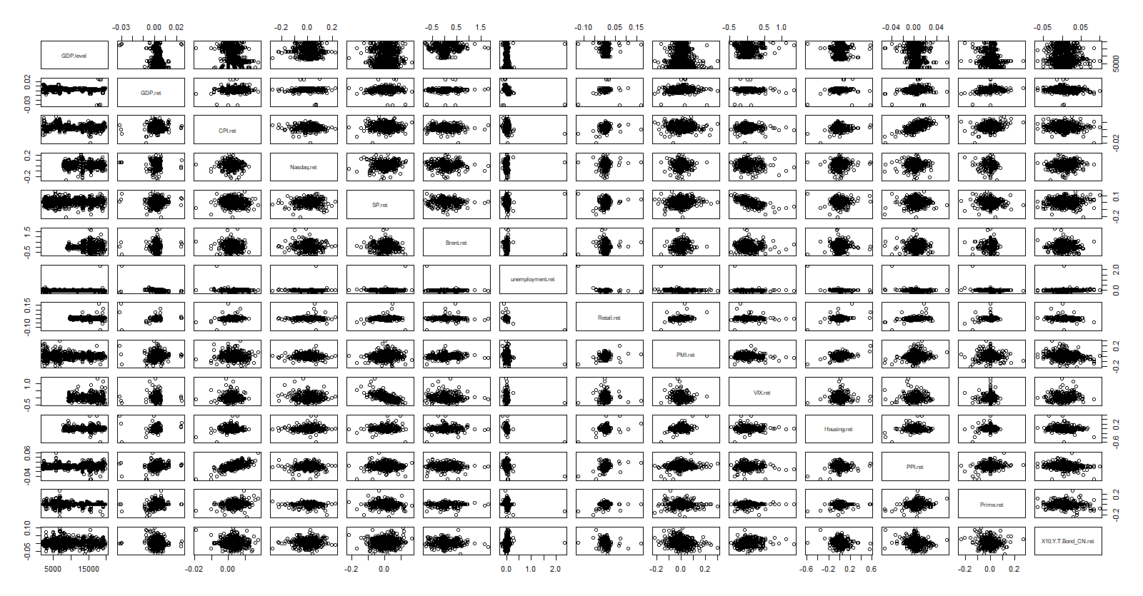
Pairs Plot to Check for Skewness
Unemployment shows a clear skewness
We then take the log of unemployment
This resolves the issue

Slide 9
Modeling

Slide 10
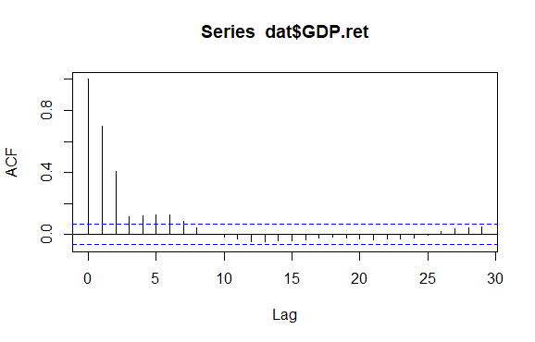
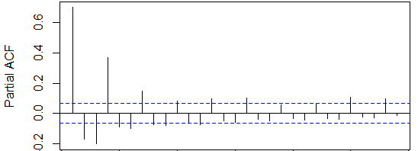
ACF and PACF of GDP Ret
ACF shows correlation until lag 7
PACF tails off suggesting an MA(7) model

Slide 11
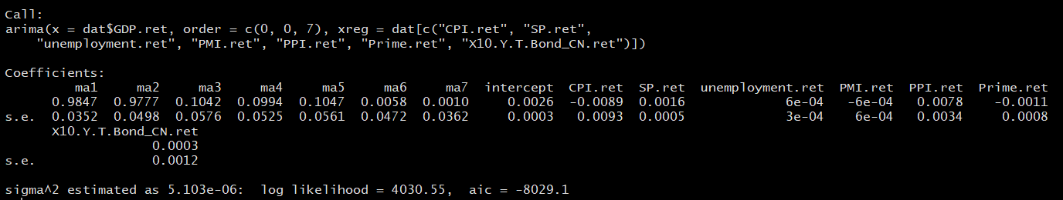
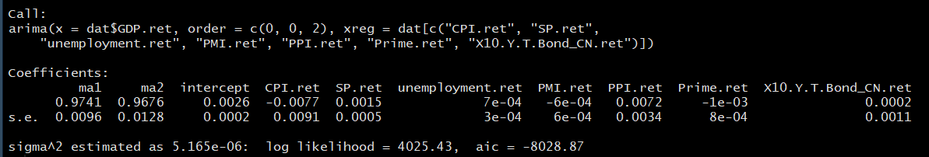
Checking the MA(7) model
MA(3) to MA(7) are insignificant, so we adjust to an MA(2) model

Slide 12
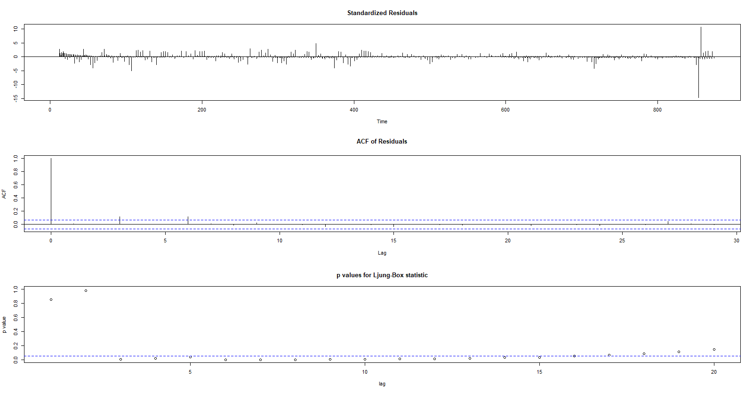
MA(2) Model Adequacy - TS Diag

Slide 13
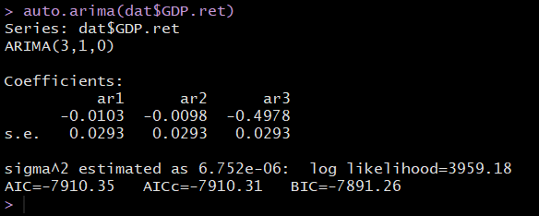
Auto Arima
Auto Arima suggests ARIMA (3,1,0) model
Used as a starting point

Slide 14
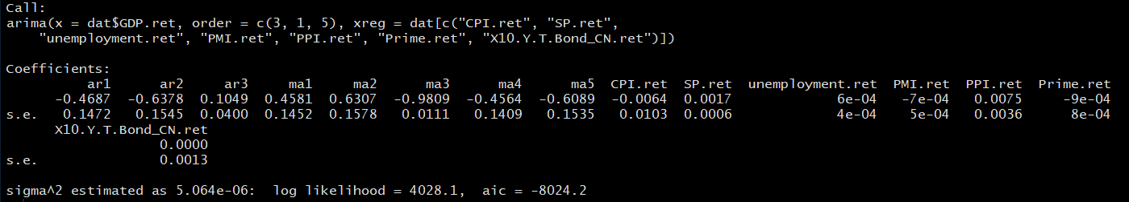
Best Model - ARIMAX (3,1,5)
T-stats

Slide 15
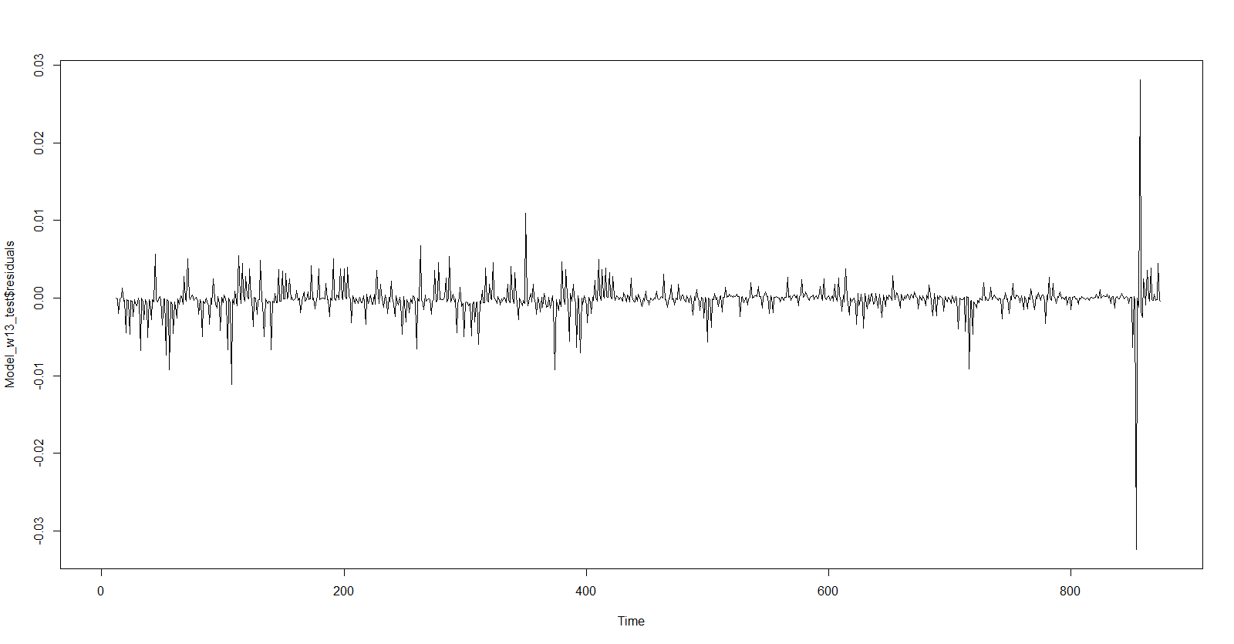
Residual Variance
Unequal variance in residuals

Slide 16
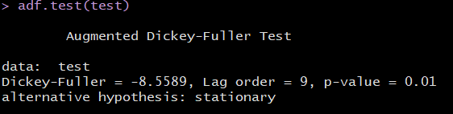
ADF Test
Residuals are stationary at significance level 0.05

Slide 17
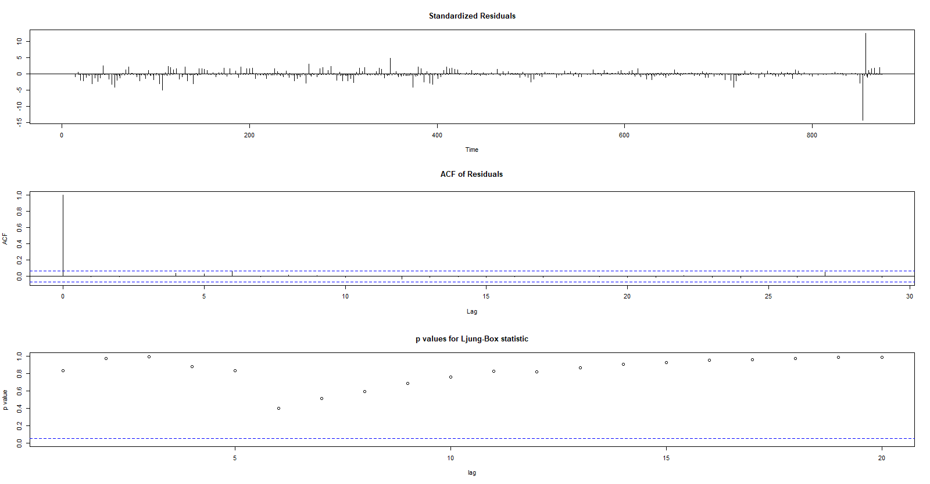
ARIMAX(3,1,5) Model Adequacy - TS Diag

Slide 18
Analysis

Slide 19
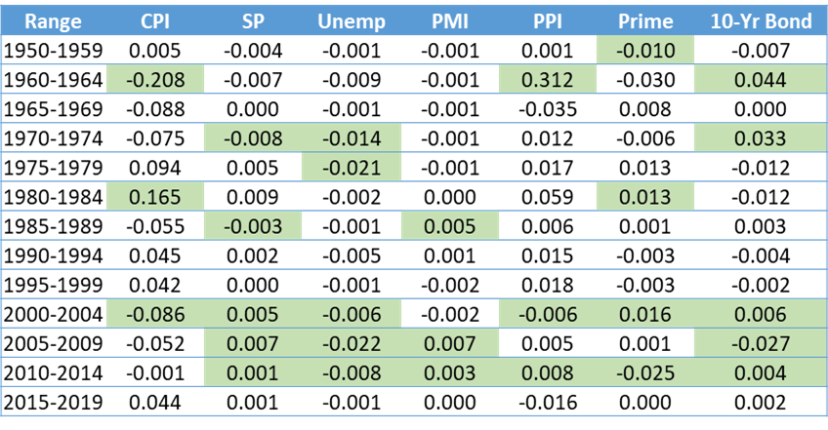
Model 1 Results
Most Consistent:
Unemployment
Negative relationship
10-Year
Positive relationship
S&P500
Relationship fluctuates
Green indicates that the beta is significant at the 5% level.

Slide 20
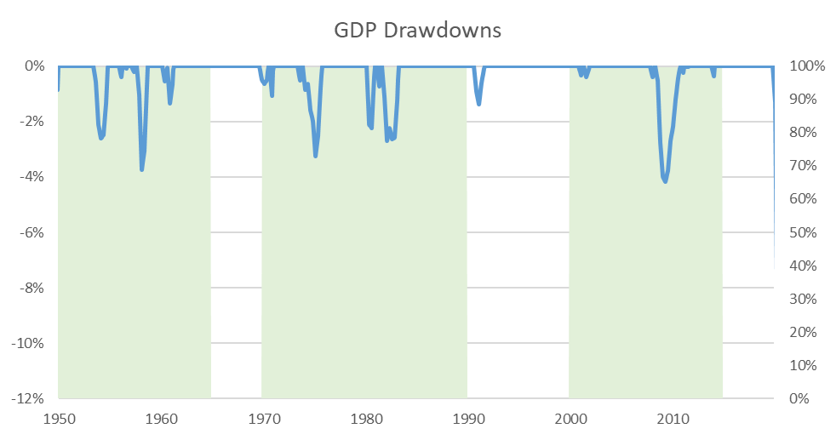
Model 1 Indicator Significance and Drawdowns
Most Consistent:
Periods with GDP drawdown tend to have at least one significant beta
Green indicates at least one exogenous beta is significant at the 5% level.

Slide 21
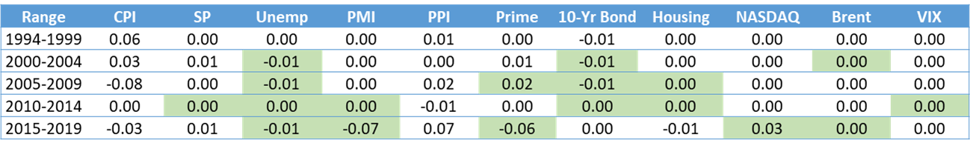
Model 2 Results
Same specs. Introduced additional variables on top of model 1
Compare the output to model 1 for the same period
Hidden relationship(e.g confounding effect) of original variables are uncovered by control for the set of new variables
Temporal changes of effect.
Green indicates that the beta is significant at the 5% level.

Slide 22
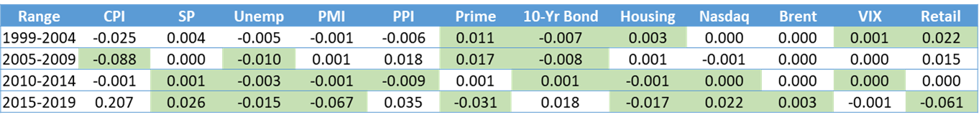
Model 3 Results
Same specs as model 2. Introduced additional one variable(retail sales)
Compare the output to model 2 for the same period
Hidden relationship(e.g confounding effect) of original variables are uncovered by control for the set of new variables
Temporal changes of effect.
Green indicates that the beta is significant at the 5% level.

Slide 23
Questions?

